Slide 1
Not User Friendly
Members: Brad Barker, Alex Gilbert, Jacob Ensor

Slide 2
Design
Mobile Platform
Android
Cloud Product
Google App Engine
Source Control
Github
Network
If phone is connected to Wifi it uses that
Defaults to 3G

Slide 3
Devices Supported
Android Smart Phones
Android Tablets

Slide 4
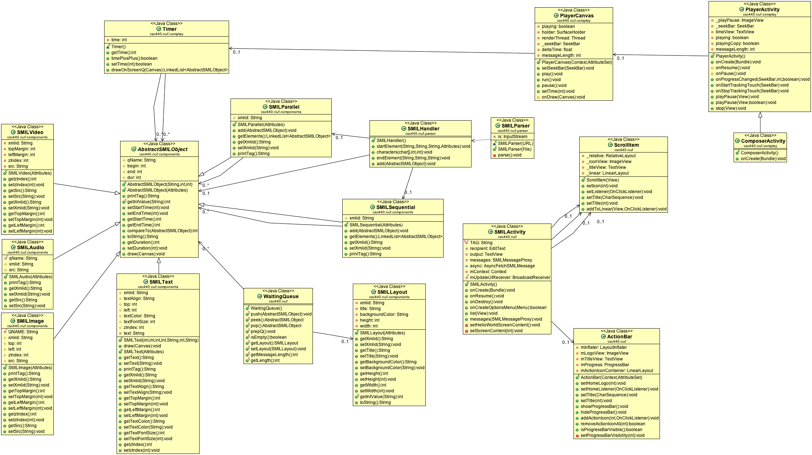
Client Uml Diagrams

Slide 5
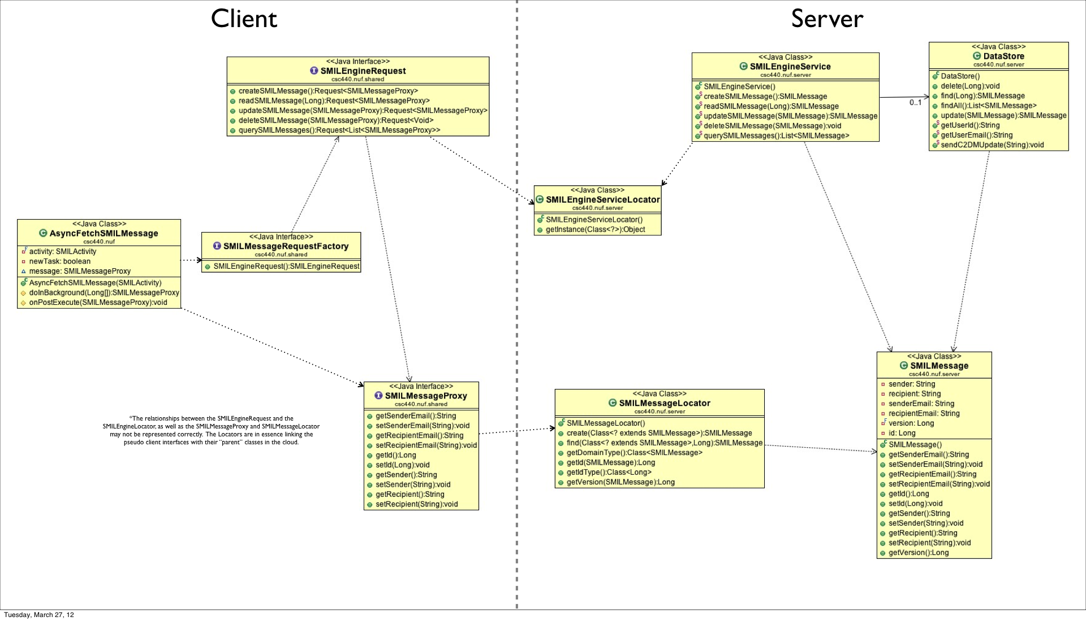
Server Uml Diagrams

Slide 6
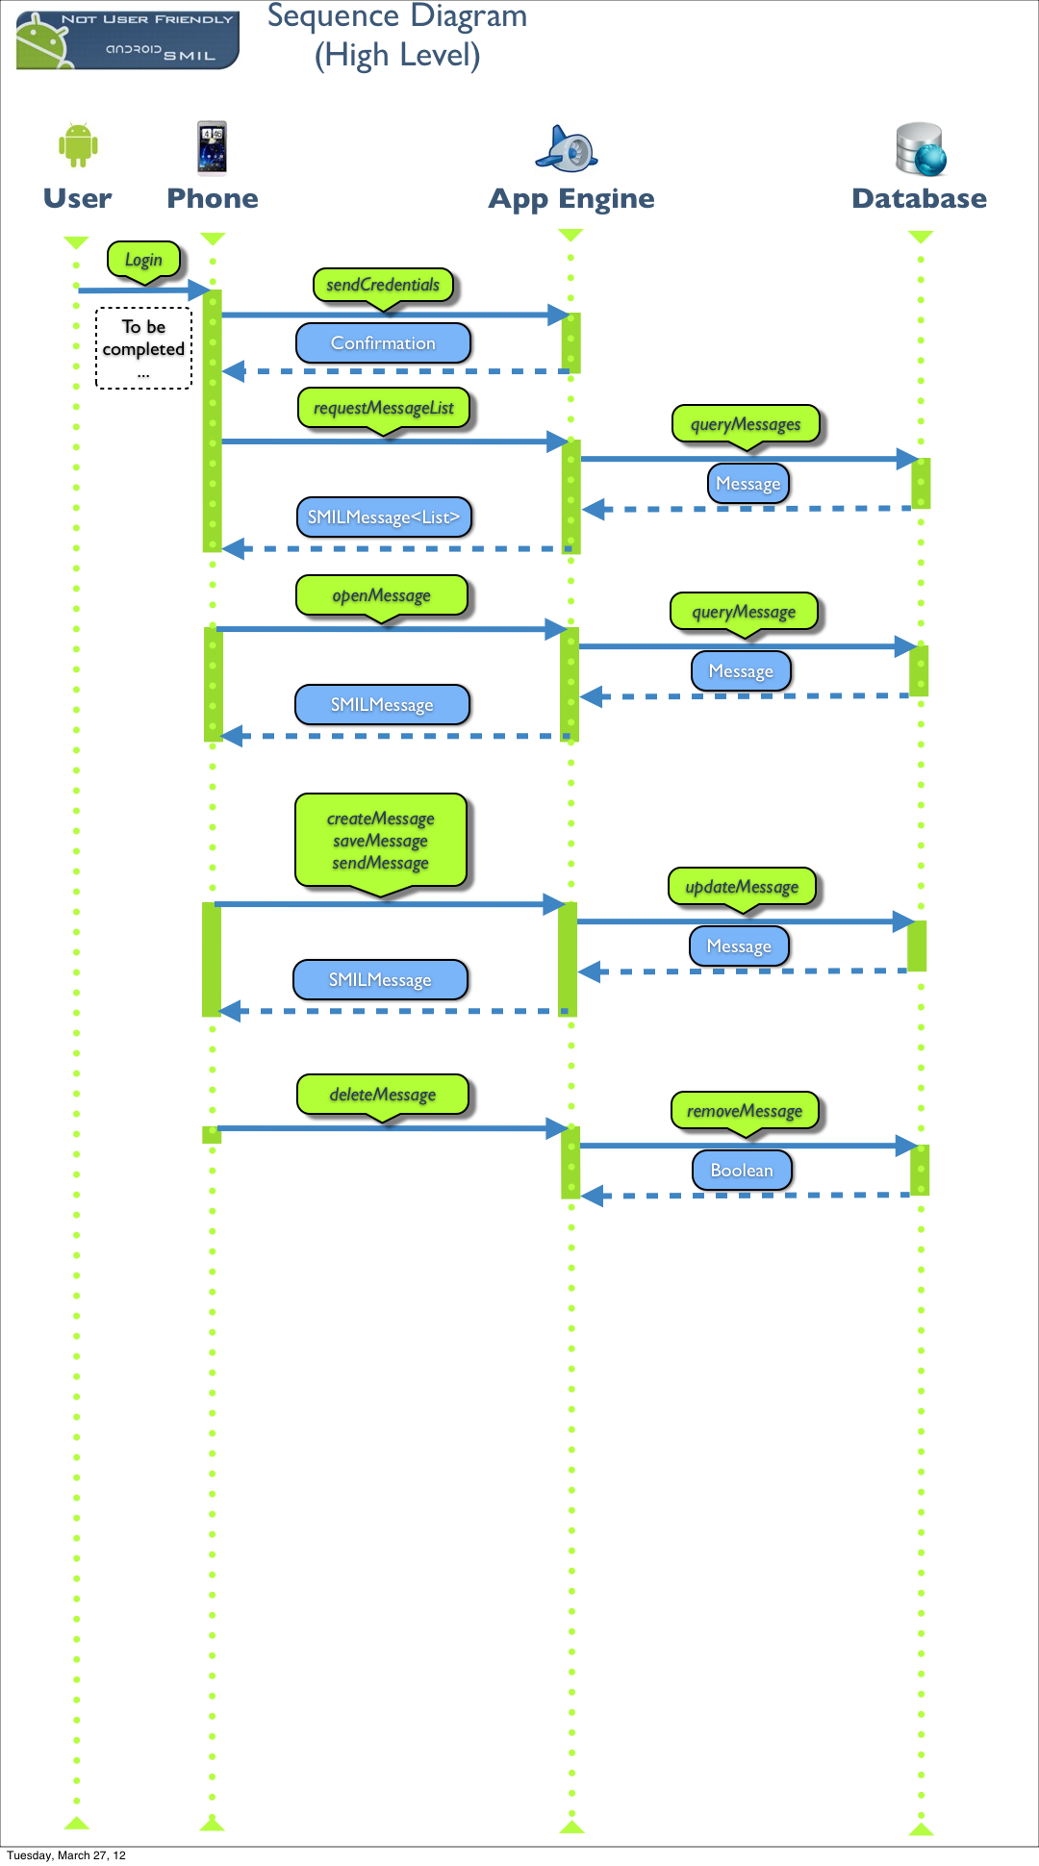
High Level Sequence Diagram

Slide 7
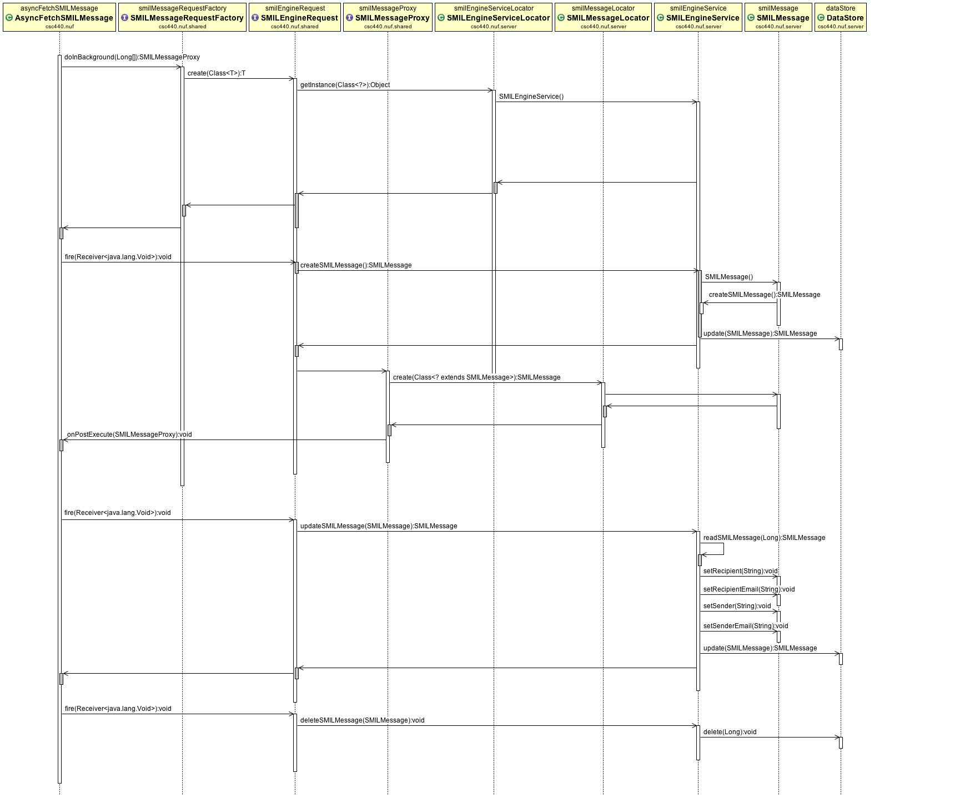
Cloud Sequence Diagram

Slide 8
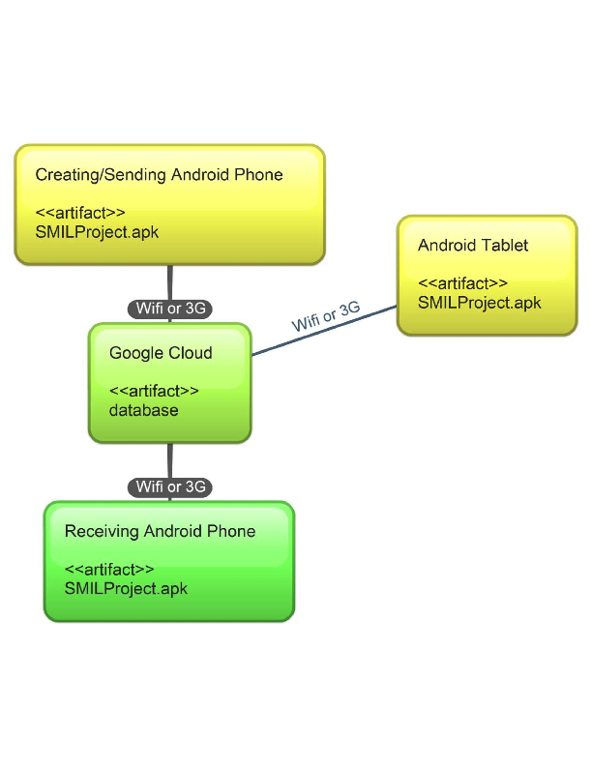
Deployment Diagram

Slide 9
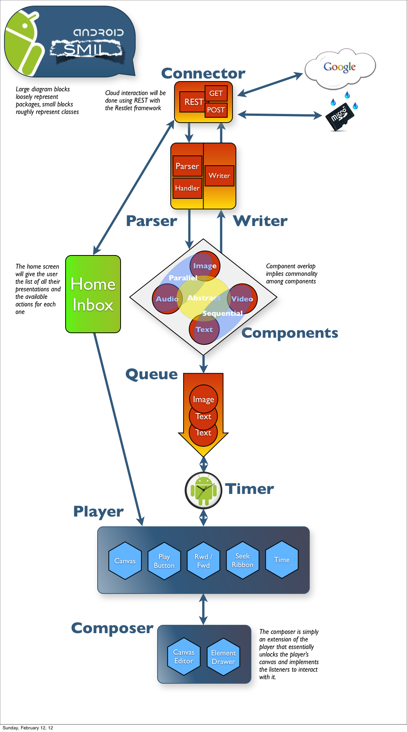
High Level Diagram

Slide 10
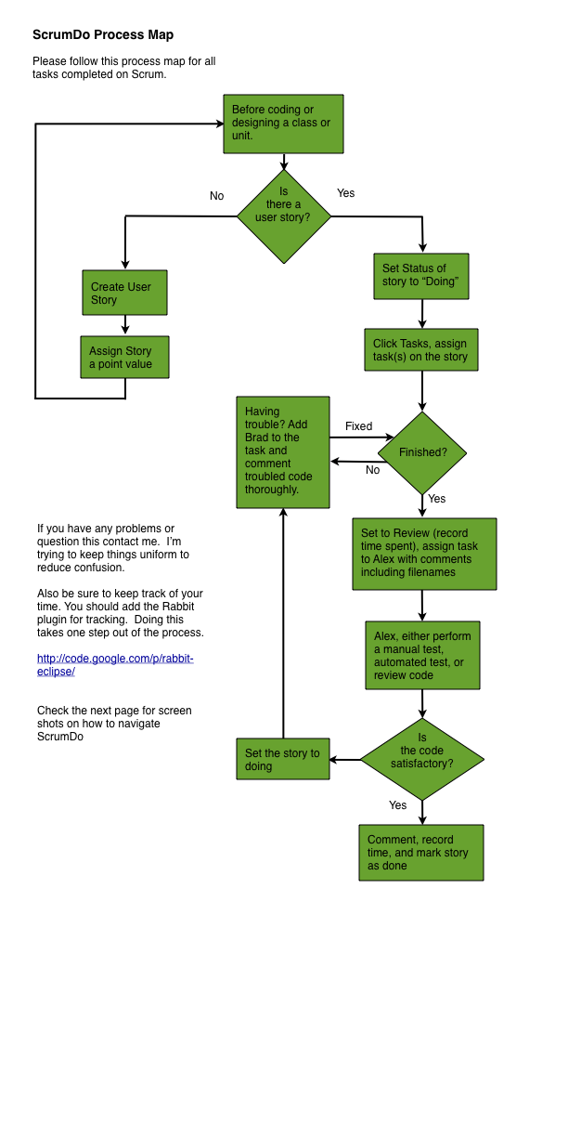
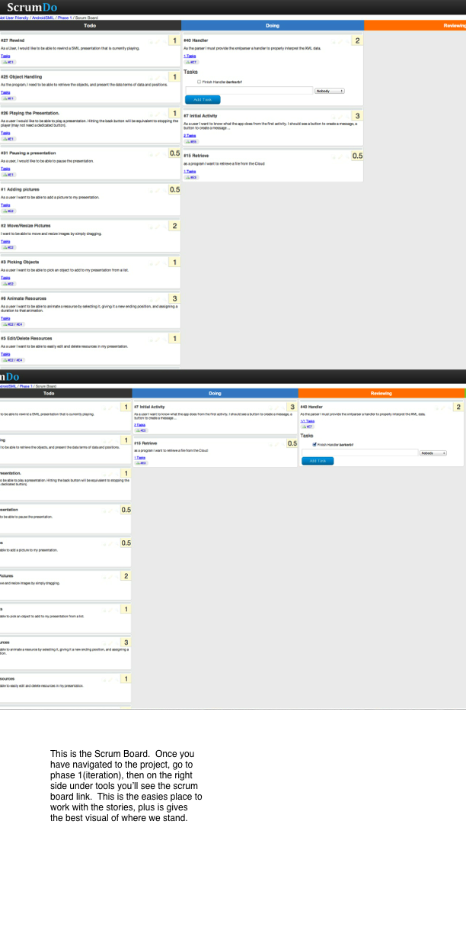
Task Process Map

Slide 11
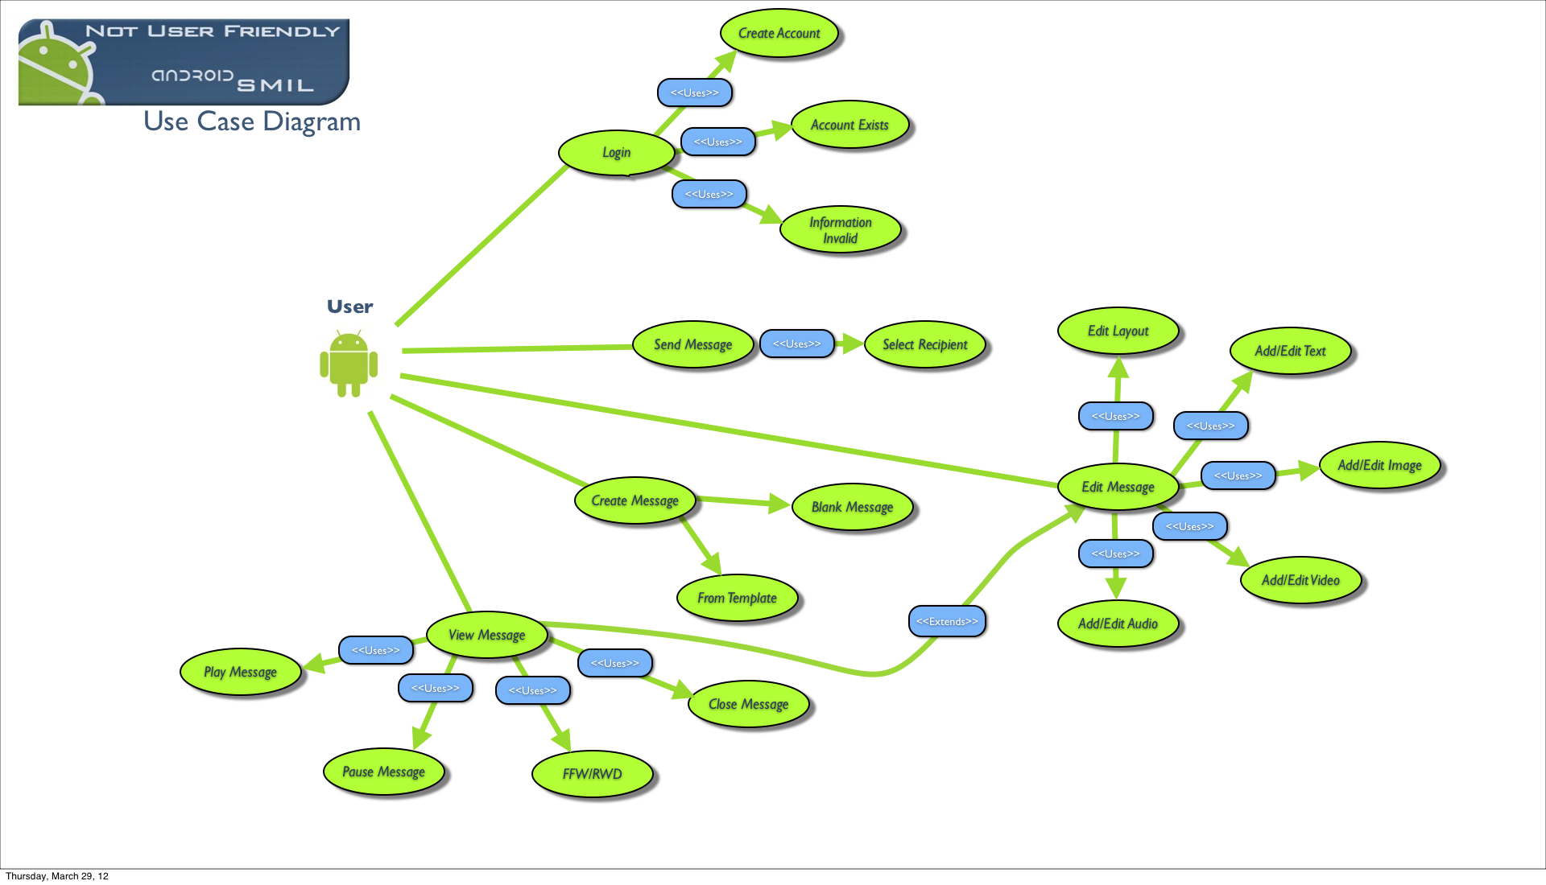

Slide 12
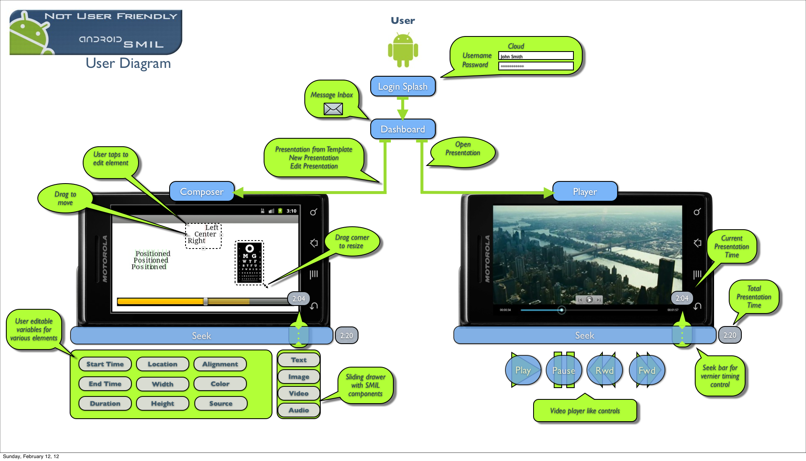

Slide 13
For the Next Class
Do not use Google App Engine.
If they do decide to use the Google App Engine, tackle that first.

Slide 14
What We Would Add
Modify presentations in the Datastore instead of removing the original presentation and creating a new one.
Performance Testing
Look more into the storage side of presentations. Right now it pulls all messages from the cloud down when app starts, then opens messages according to inbox/outbox.

